Slide 1
MADÈRE
6ème JOUR
CONFINEMENT

Slide 2
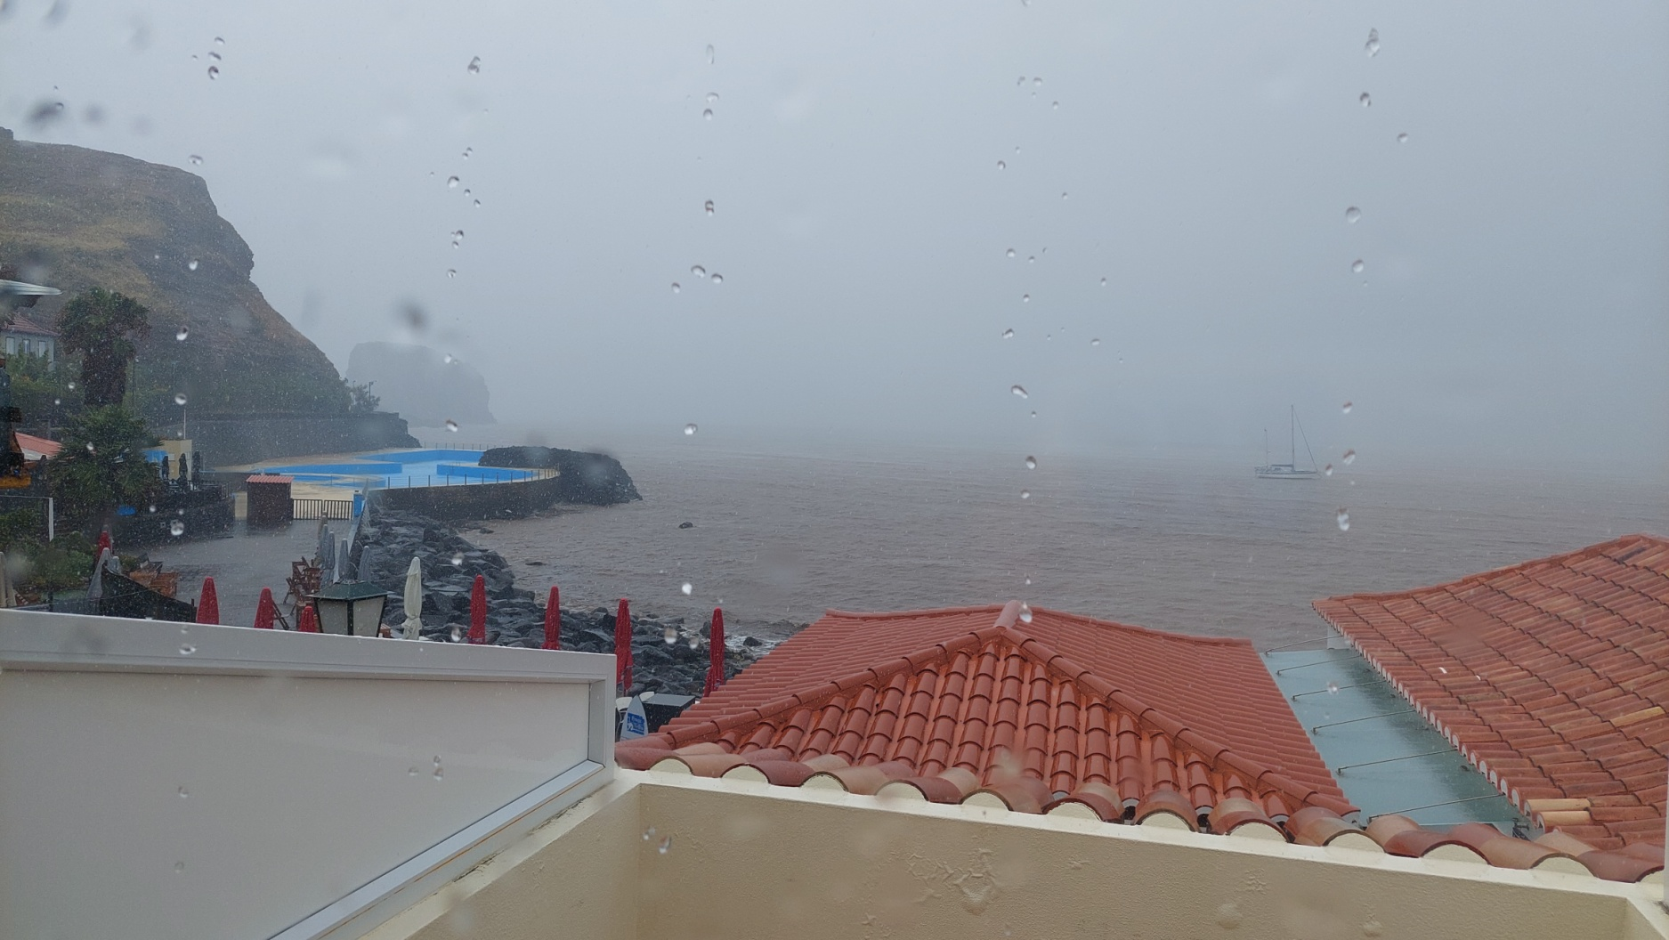
CONFINEMENT

Slide 3
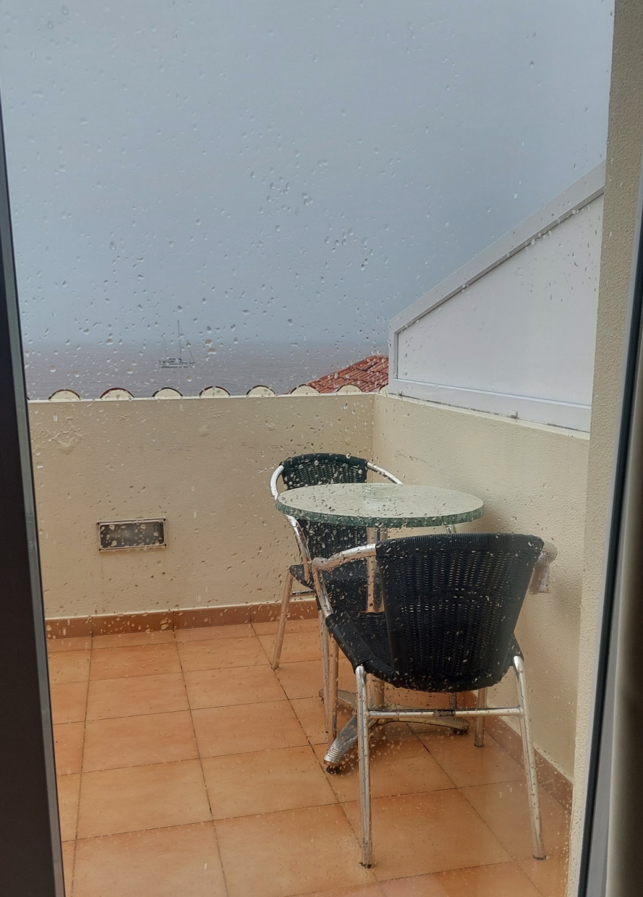
CONFINEMENT

Slide 4
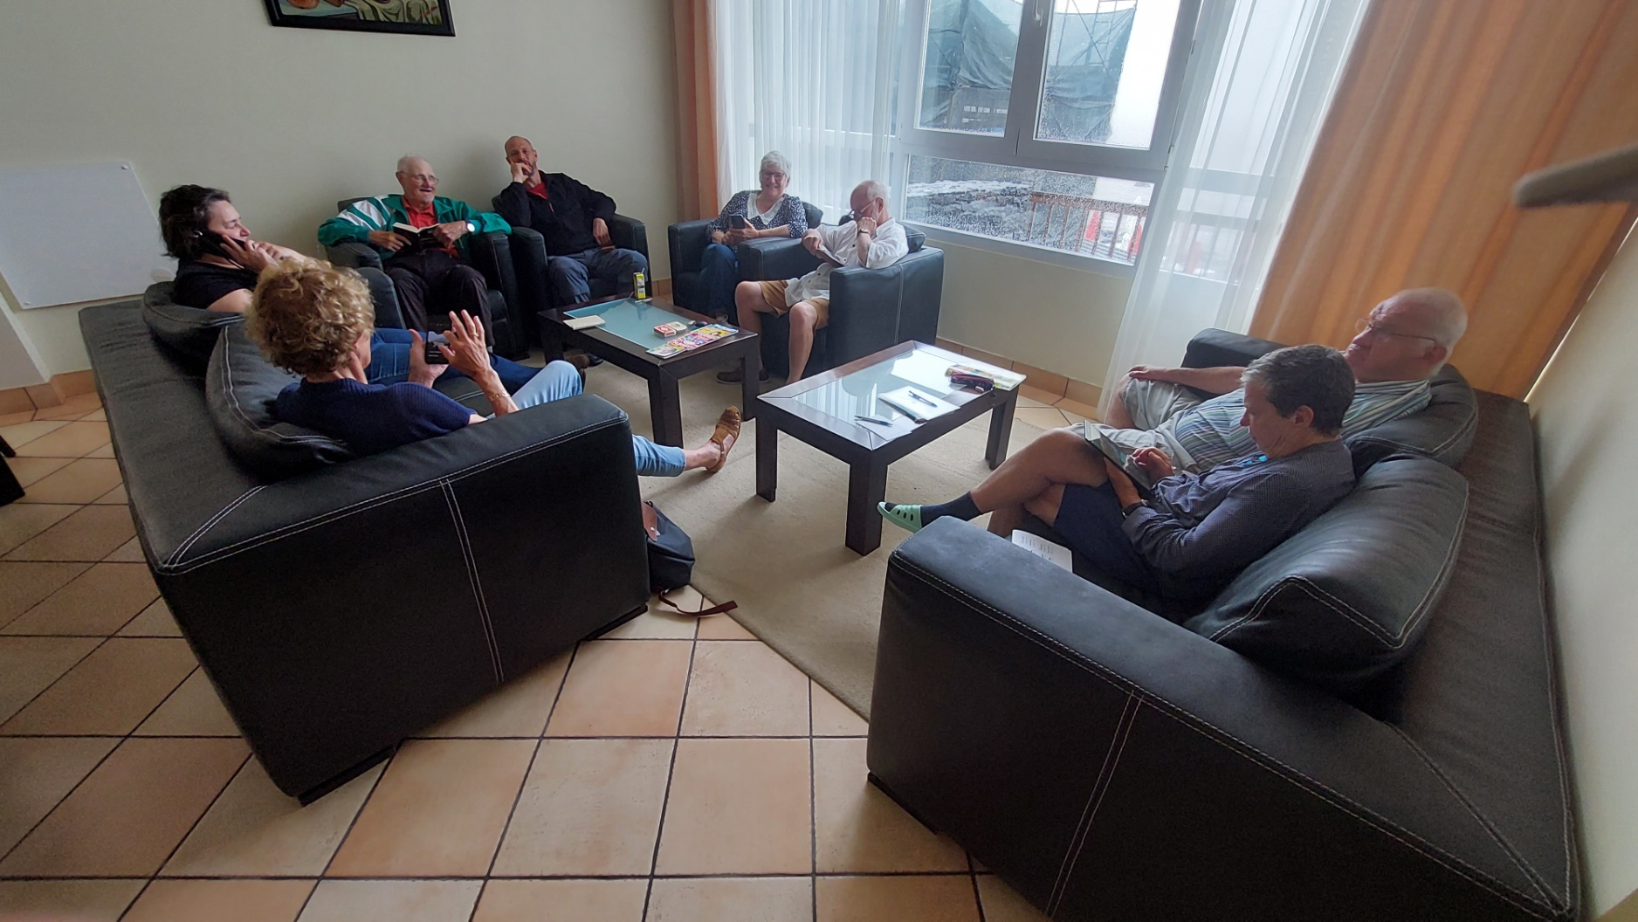
CONFINEMENT

Slide 5
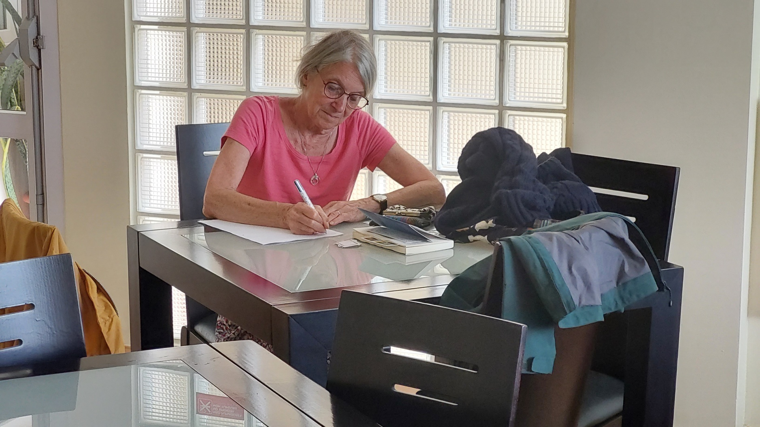
CONFINEMENT

Slide 6
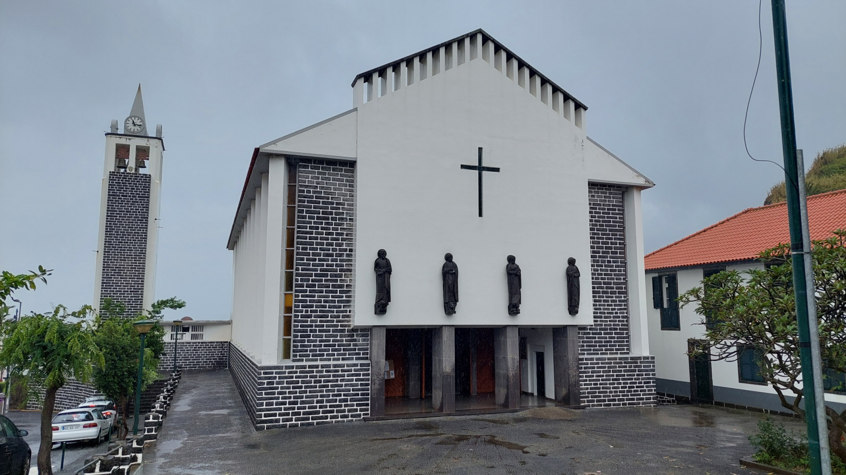
CONFINEMENT

Slide 7
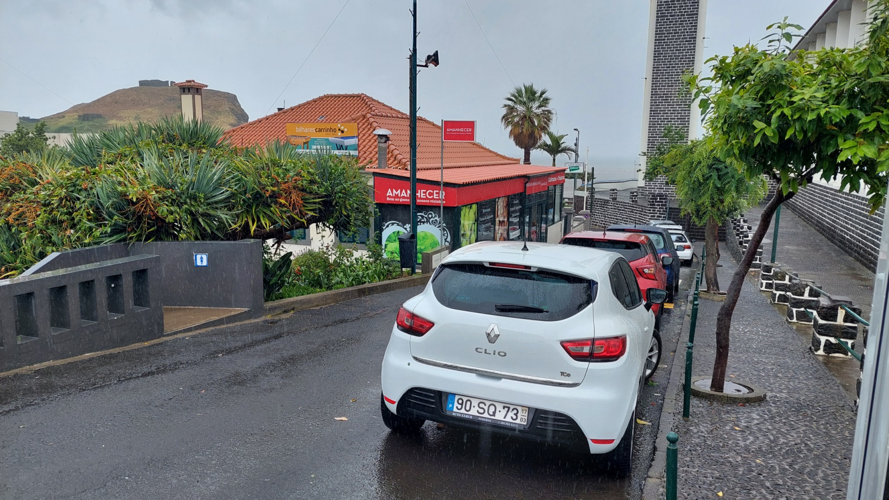
CONFINEMENT

Slide 8
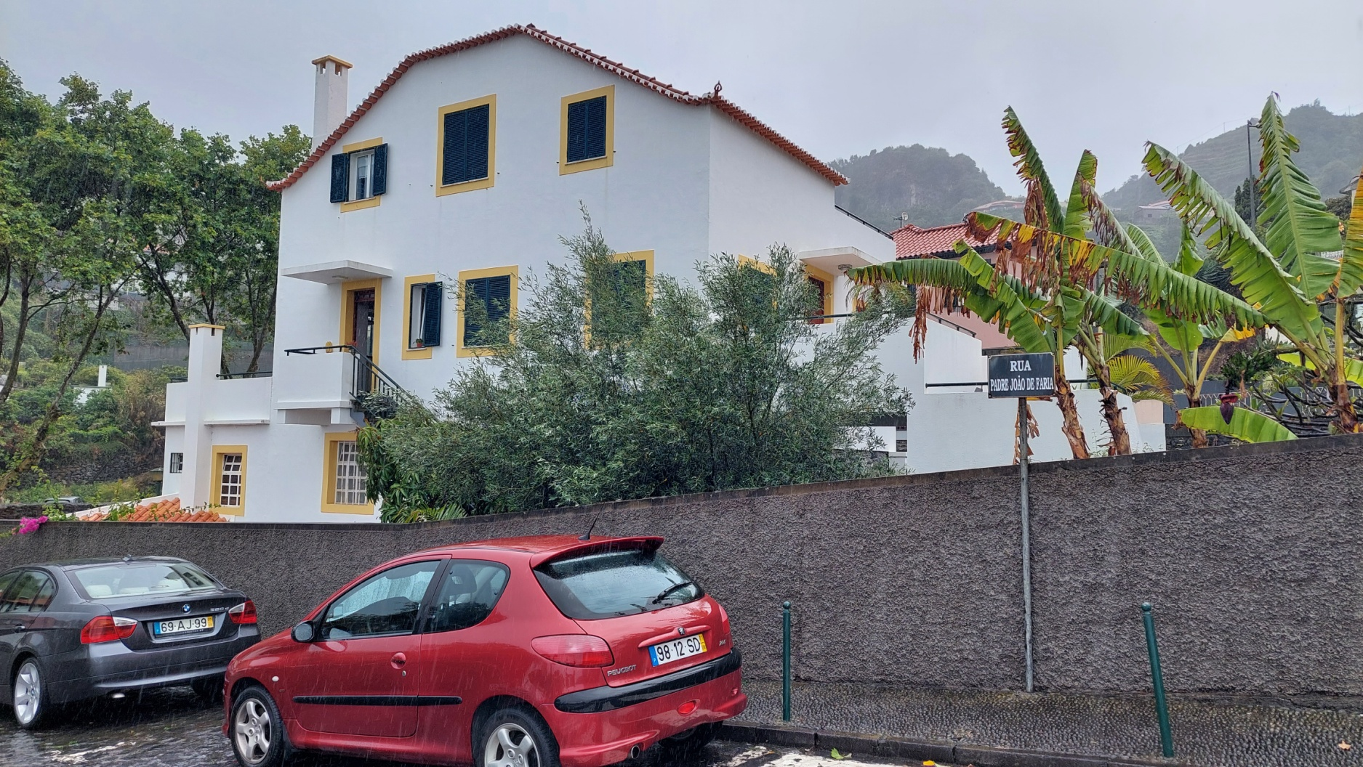
CONFINEMENT

Slide 9
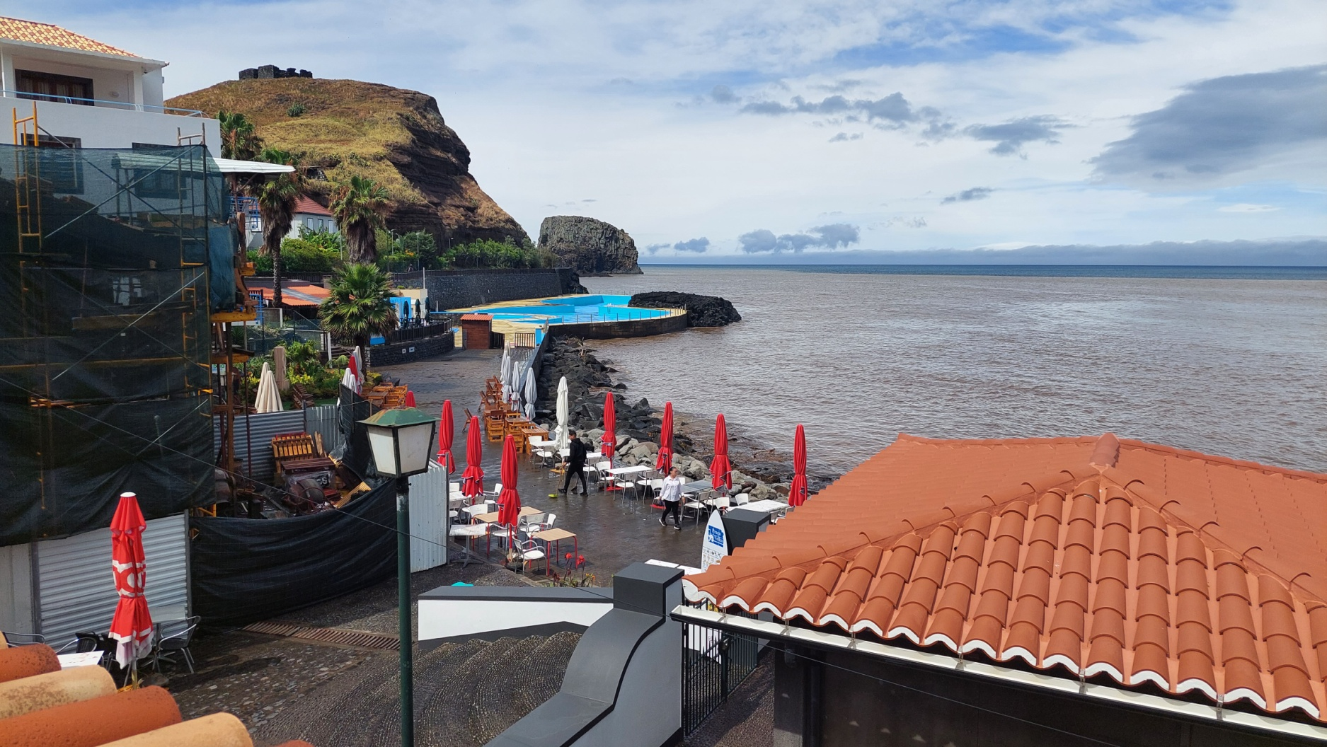
CONFINEMENT

Slide 10
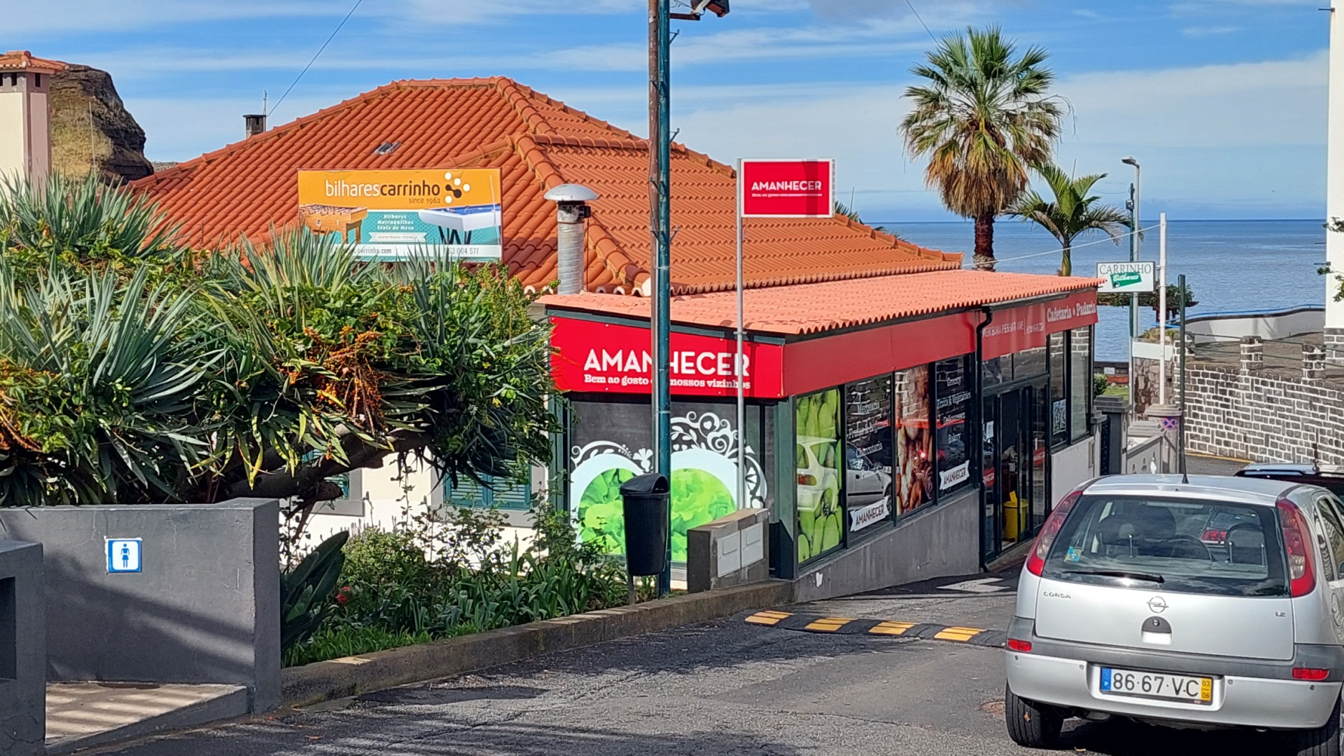
CONFINEMENT

Slide 11
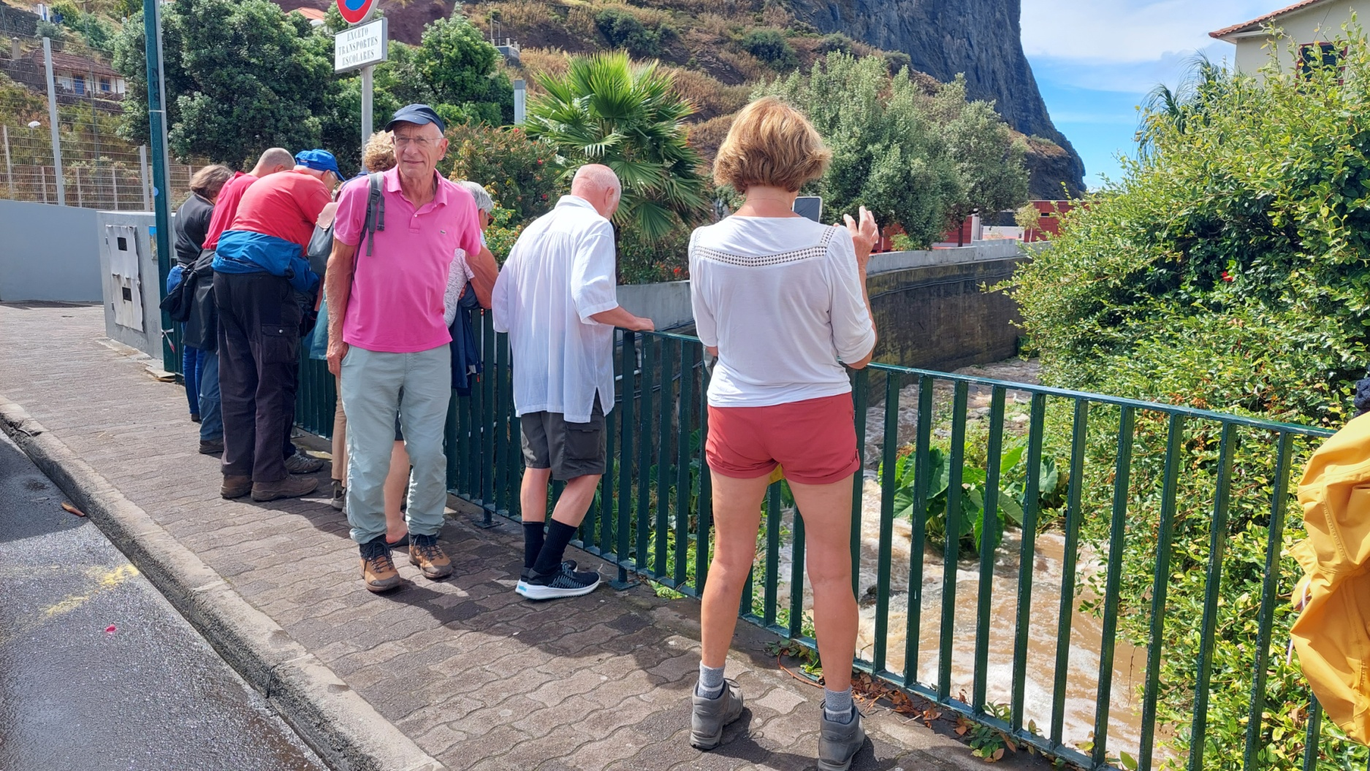
CONFINEMENT

Slide 12
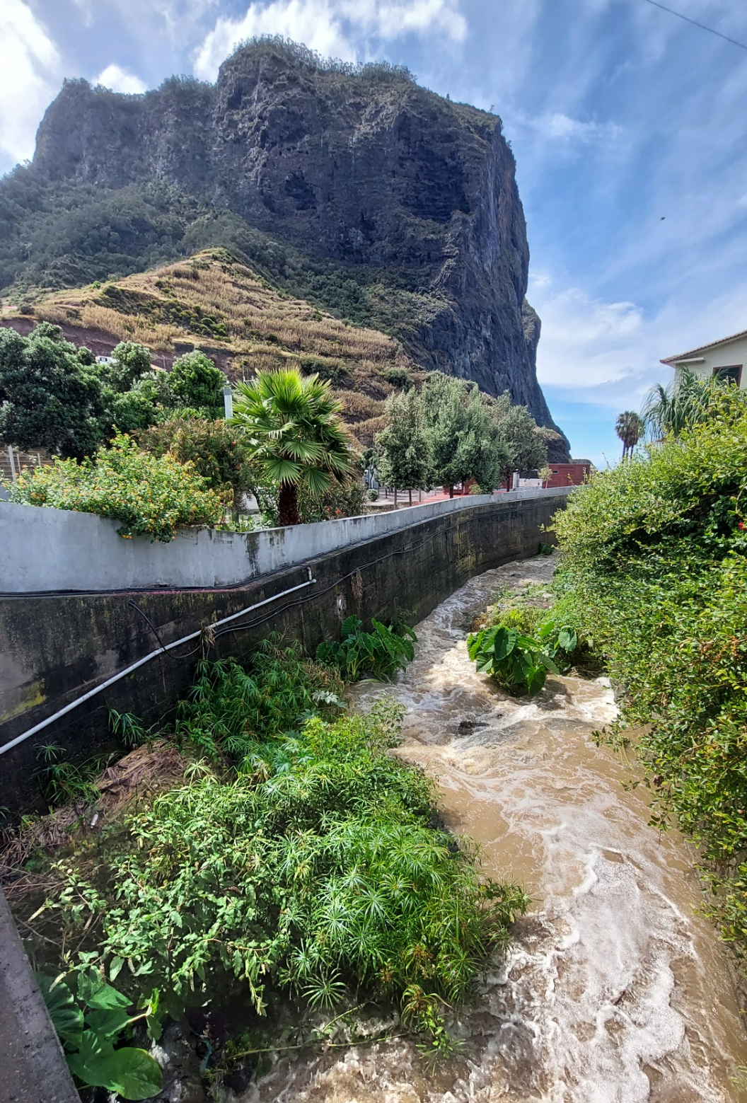
CONFINEMENT

Slide 13
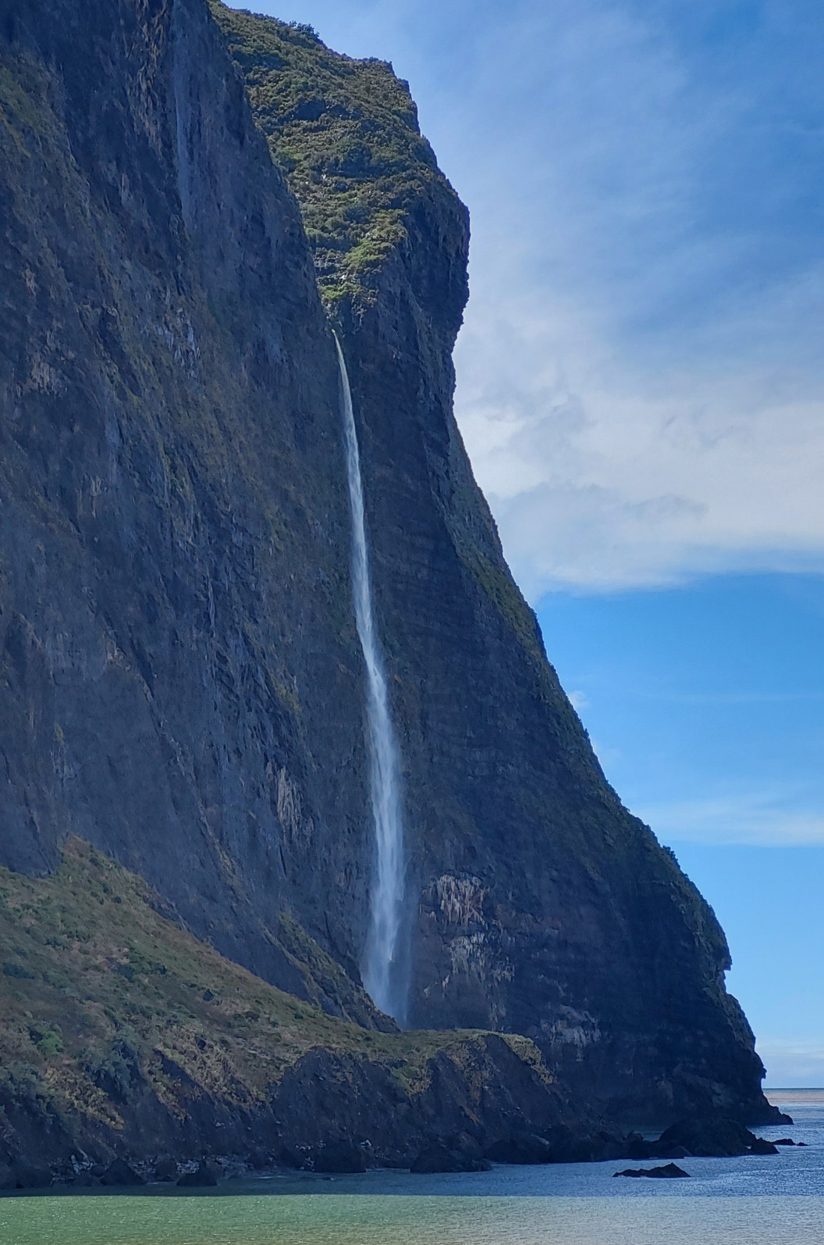
CONFINEMENT

Slide 14
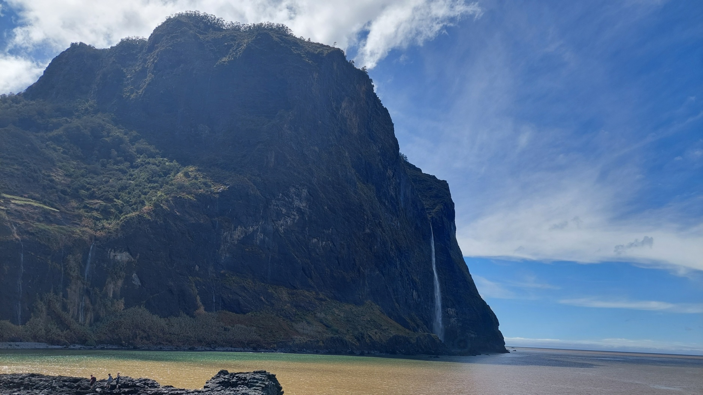
CONFINEMENT

Slide 15
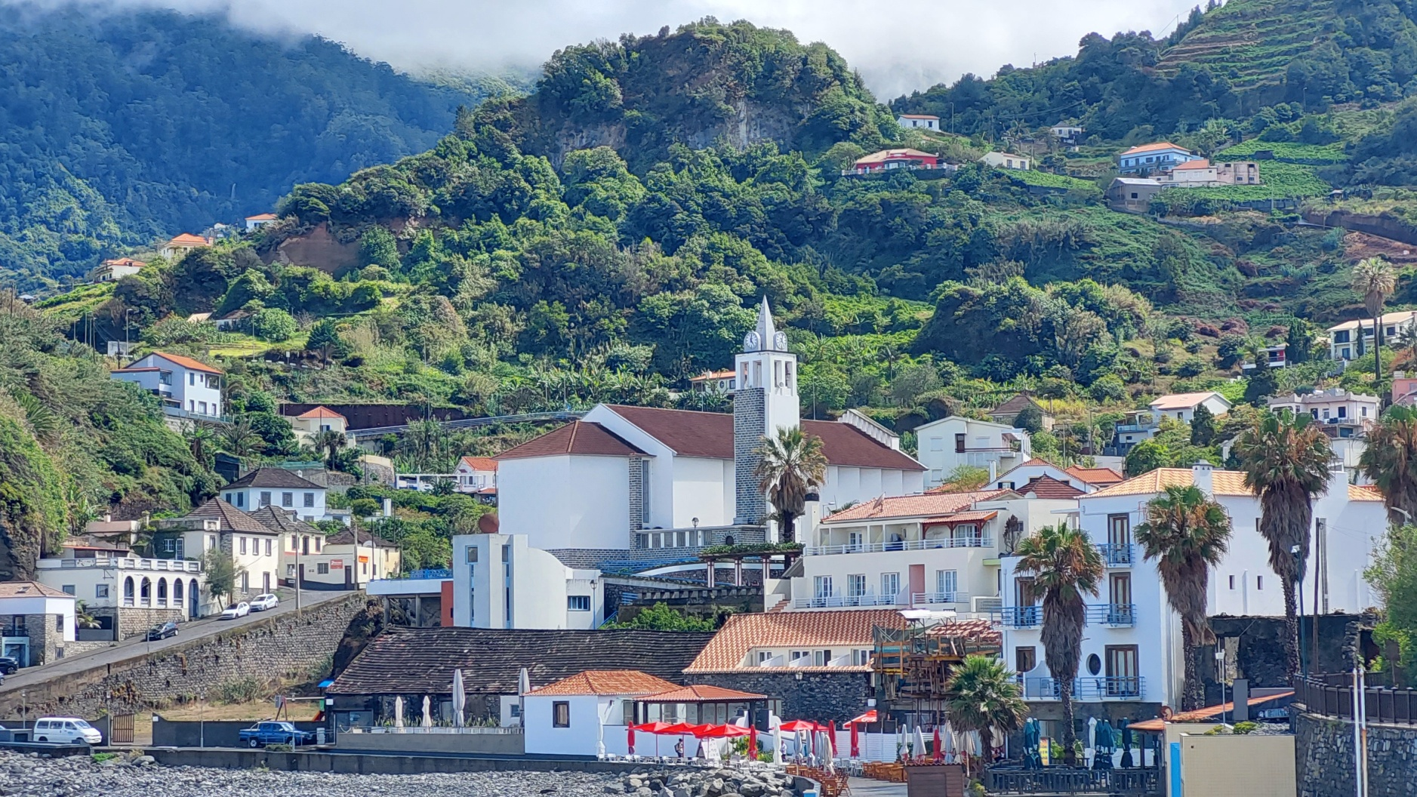
CONFINEMENT

Slide 16
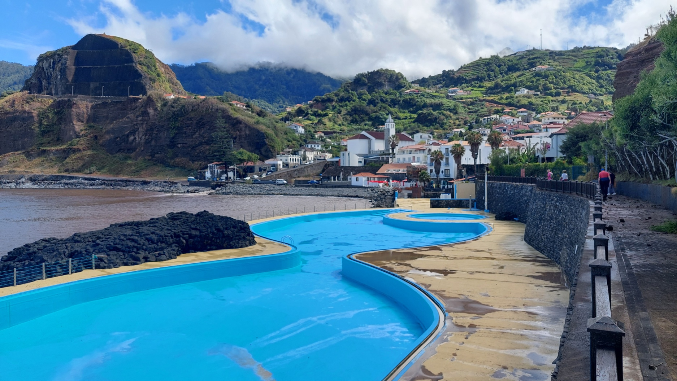
CONFINEMENT

Slide 17
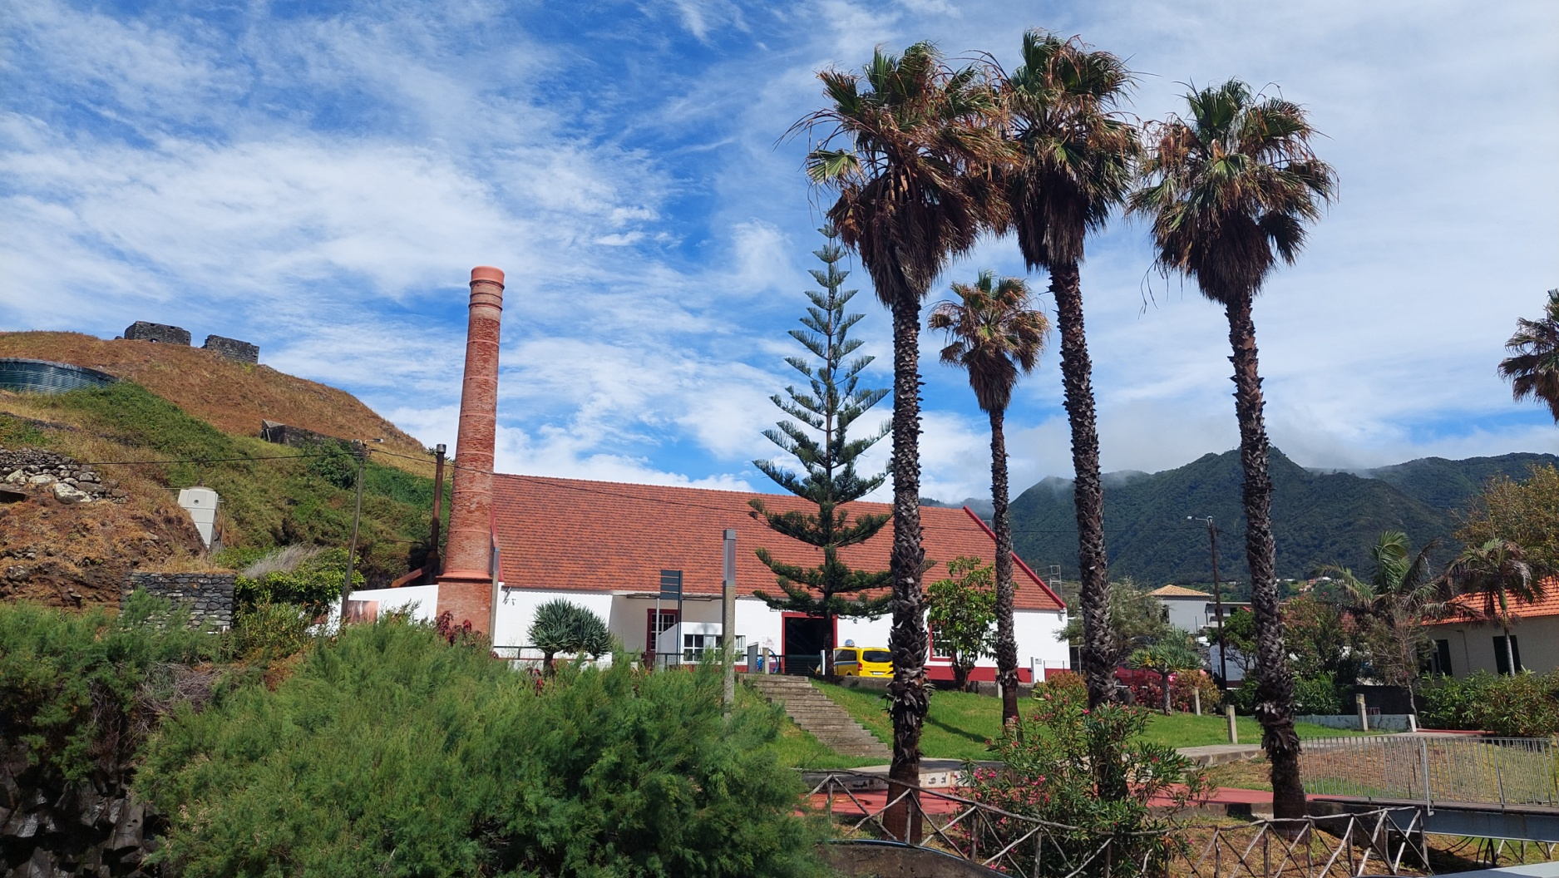
CONFINEMENT

Slide 18
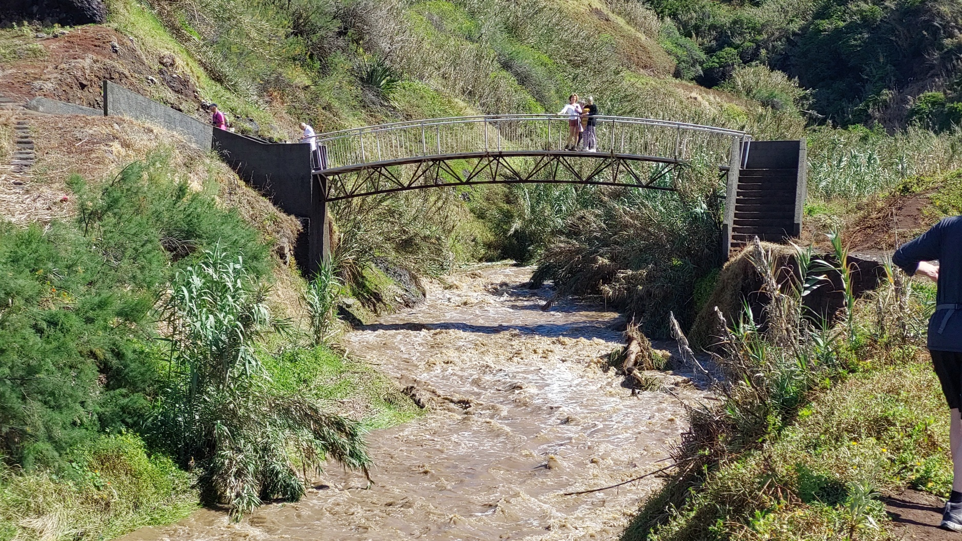
CONFINEMENT

Slide 19
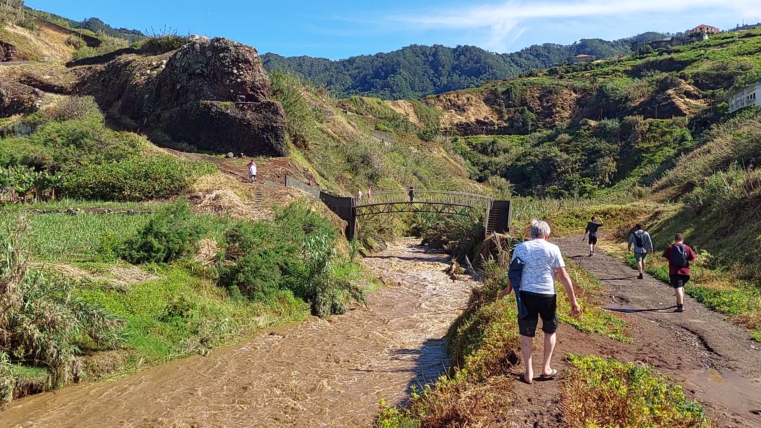
CONFINEMENT

Slide 20
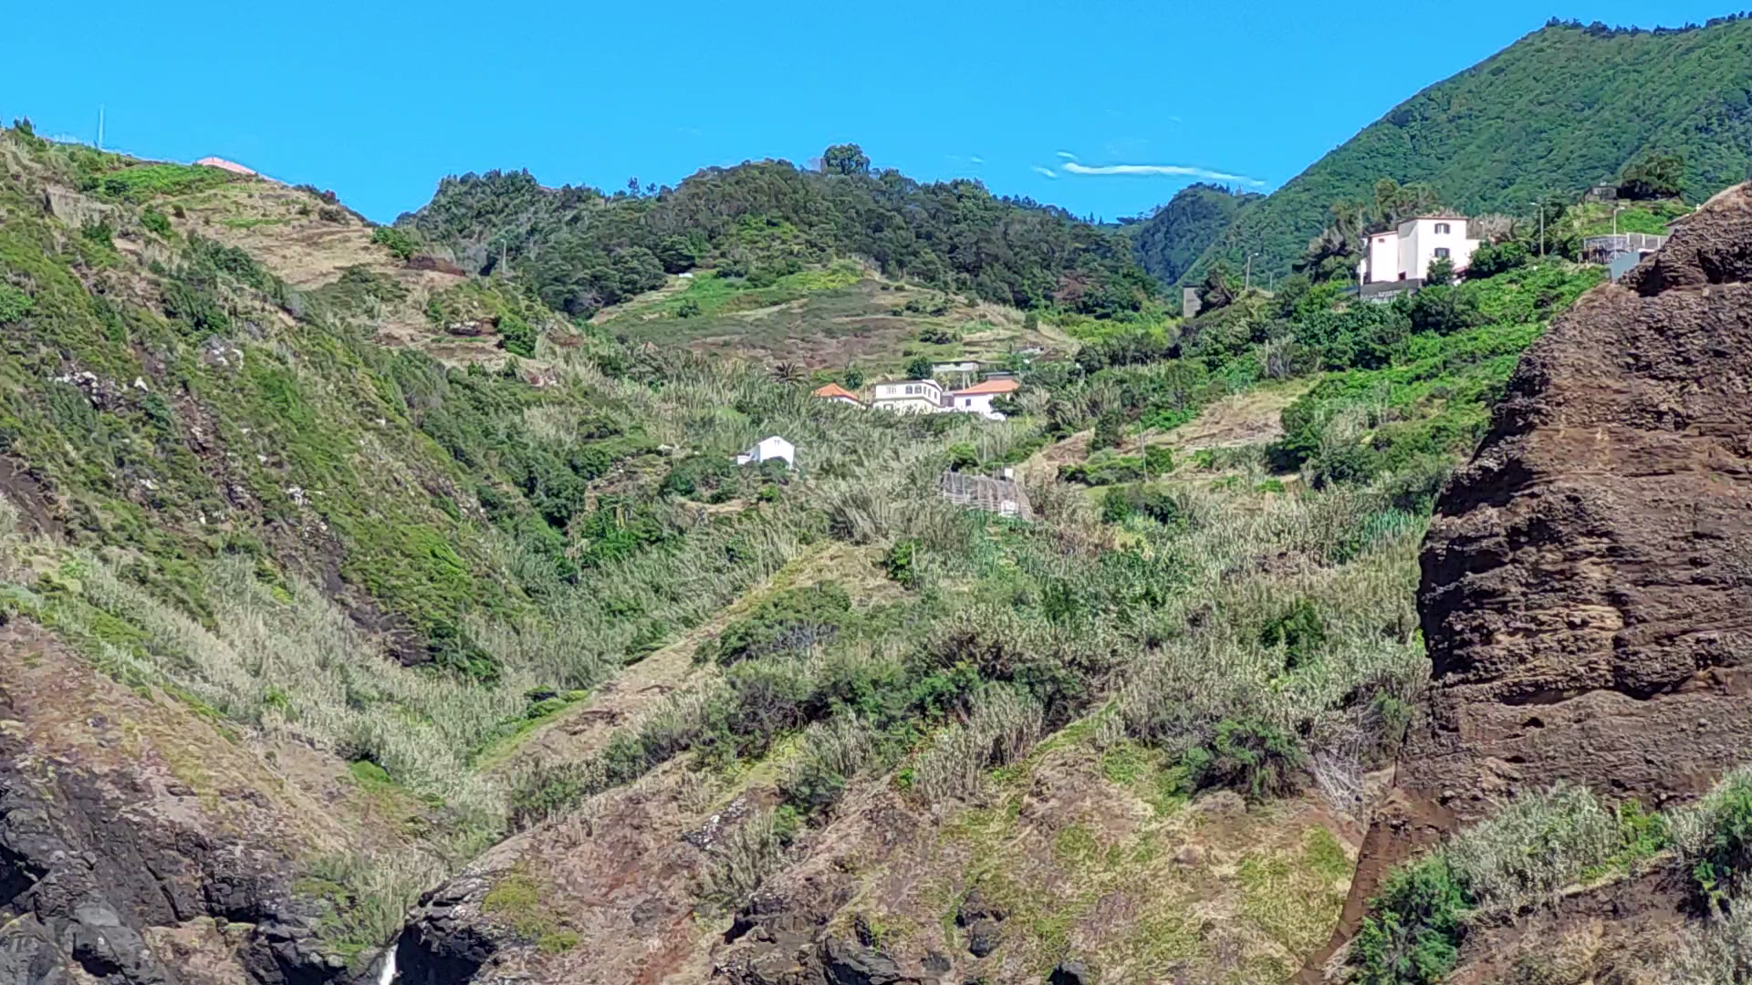
CONFINEMENT

Slide 21
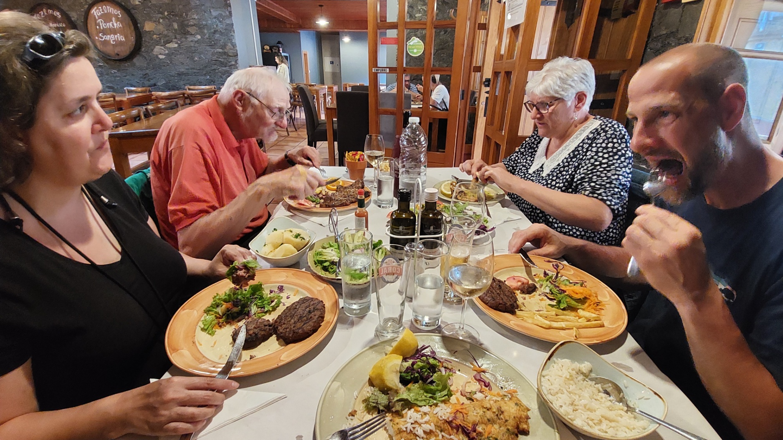
CONFINEMENT

Slide 22
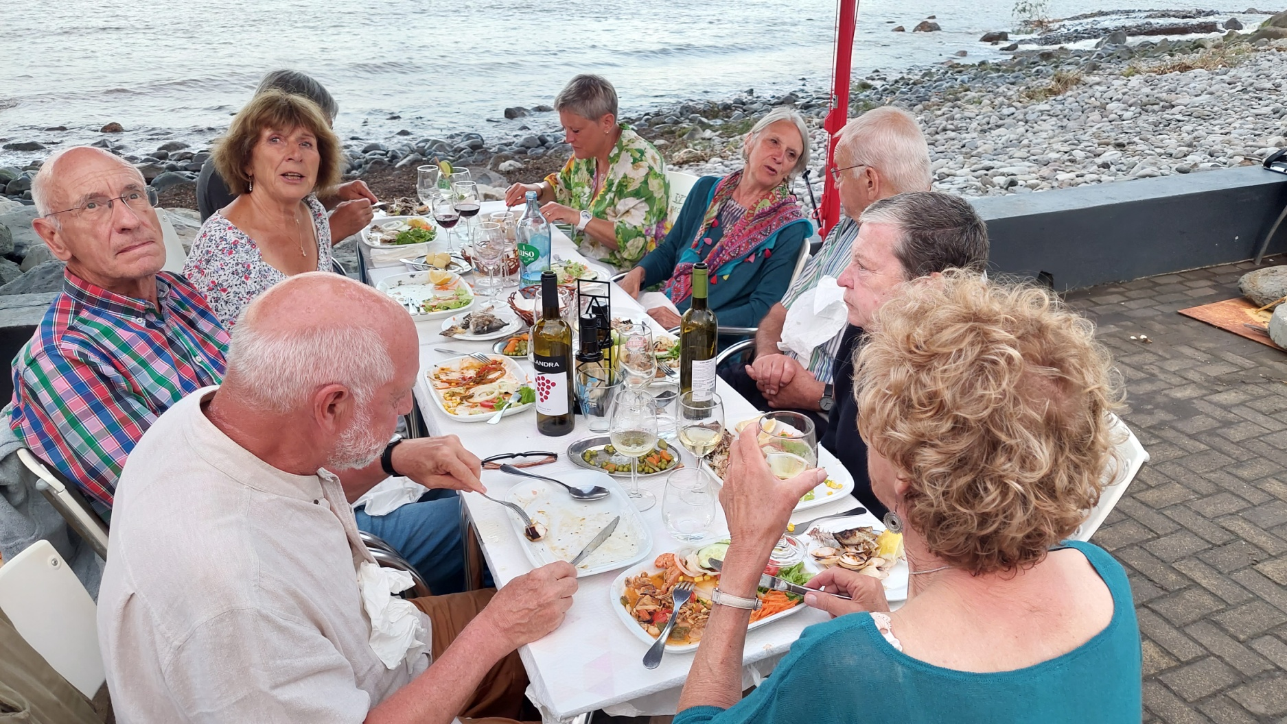
CONFINEMENT

